Slide 1
5205 Presentation
Group 29: Chen Liu, Yewen Li

Slide 2
Introduction
Our project focuses on examining patterns related to ADHD diagnosis and sex differentiation
We got our datasets from the WiDS Datathon 2025, which are provided by the Healthy Brain Network (HBN)

Slide 3
Data Description
We have three datasets. The datasets include functional brain imaging data, socio-demographic information, and clinical assessments.
Brain imaging features (e.g., functional connectivity patterns)
More than 24,100,000 observations
Socio-demographic factors (e.g., age, gender, education level)
12130 observations
Clinical assessments (e.g., ADHD severity and other diagnostic criteria)
23047 observations
Notes:
base off of example slides
Classification right?s
Nor sure we need to write data description about the processed data or the original data(original)
3.1 2013 - 2.28 2017

Slide 4
Objective And Methodology
To develop predictive models to predict an individual’s ADHD diagnosis and sex based on the provided data.
Identifying patterns that could indicate ADHD diagnosis.
Exploring potential sex-based differences in ADHD presentation.
Contributing to the understanding of ADHD
Notes:
base off of example slides
I’m not sure about the model
Analyze data to education first
Predict second

Slide 5
Data Pre-Processing

Slide 6
Data Pre-Processing
Merge the three datasets into one
Addressed missing values
median-impute for quantitative values
mode imputation for categorical values

Slide 7
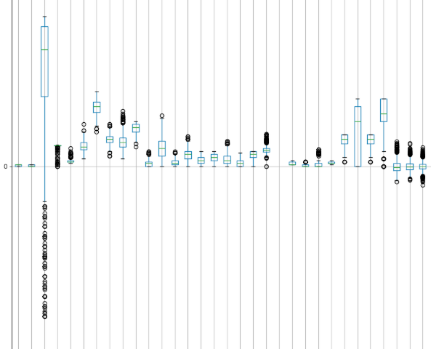
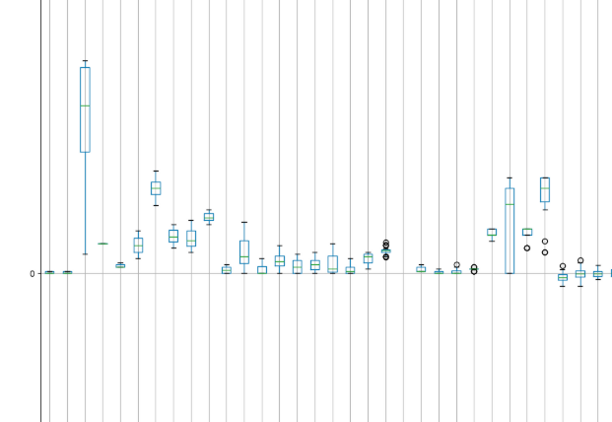
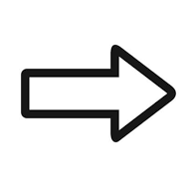
Taking care of Outliers
Used IQR method to remove outliers
Used box plots to visualize the outliers
Notes:
Outlier removal - Used IQR method to remove the outliers.
did for every variable, just couple of them in the image as examples

Slide 8
Data Pre-Processing
Process the Brain functional-connectivity data
Deduplicate edges
keep only the upper-triangle → one value per edge
Dimensionality reduction
PCA
Hot-code-encode
Apply one-hot encoding to every categorical feature, producing binary dummy variables

Slide 9
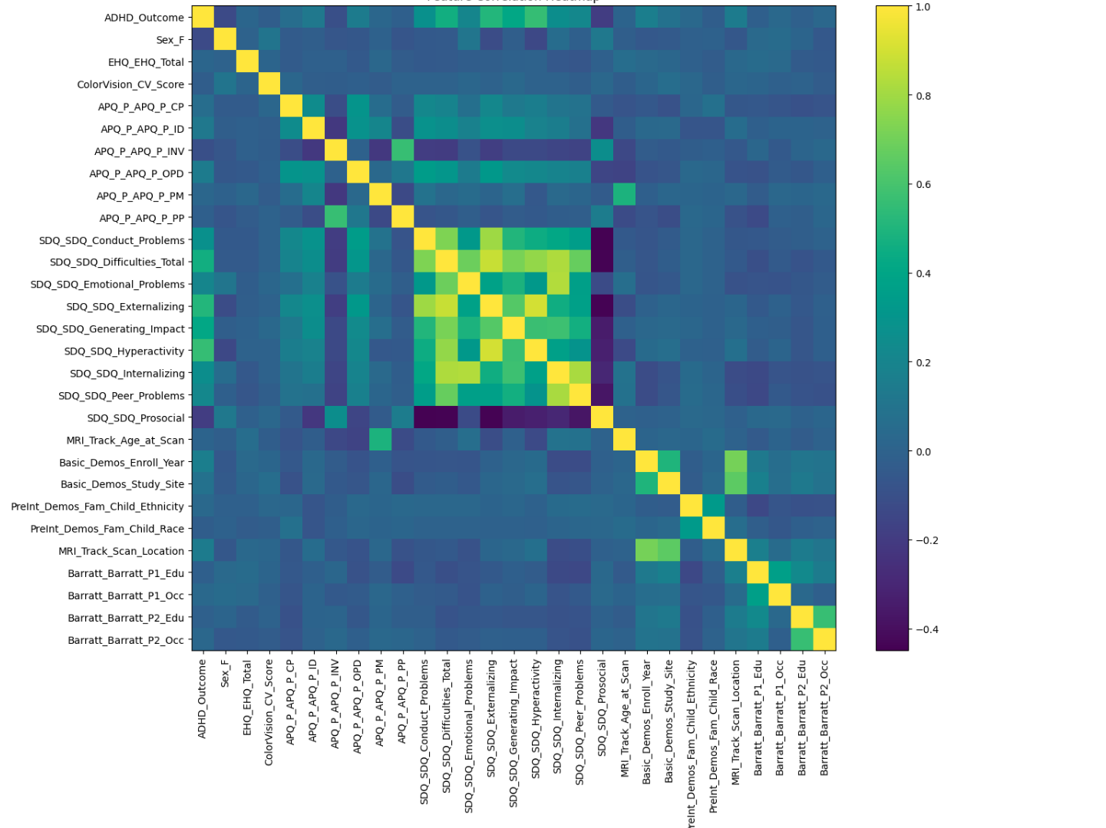
Correlation
Domain‑specific clusters
Questionnaire subscales tend to move together
Demographics stand apart
‘age’, ‘socioeconomic indicators’ tend to be uniquely informative
Using threshold of 0.8, removed 'SDQ_SDQ_Externalizing', 'SDQ_SDQ_Hyperactivity', 'SDQ_SDQ_Internalizing', 'SDQ_SDQ_Peer_Problems'
Notes:
0.8 is industry standard

Slide 10
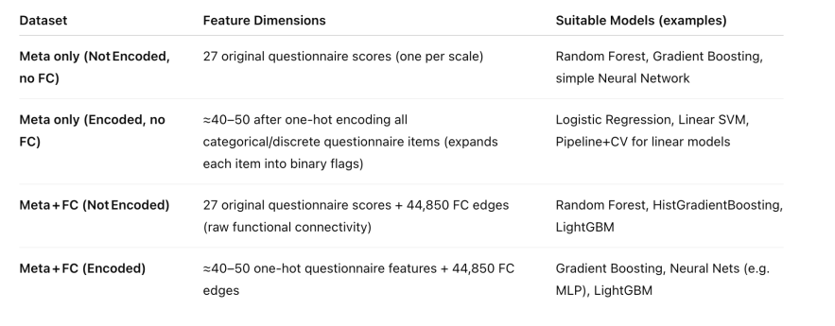
Processed Outputs

Slide 11
Model Building

Slide 12
Model Building
Choose encoded dataset version for logistic regression & not encoded for random forest
Extract two target labels (ADHD, Sex) from the original dataset
Split data into training (80%) and testing (20%) datasets
Standardize features to ensure equal contribution to model training
Feature engineering and cross-validation
Model Training
Model Evaluation
Apply on different dataset versions (Meta-only, Meta+FC, and feature-engineered versions)
Compare model AUC across dataset versions
Notes:
Ranges are different because long term(annual) exposure is more likely to have negative health effect than one bad day
consulted with client and that’s what he said

Slide 13
Model Results & Comparison

Slide 14
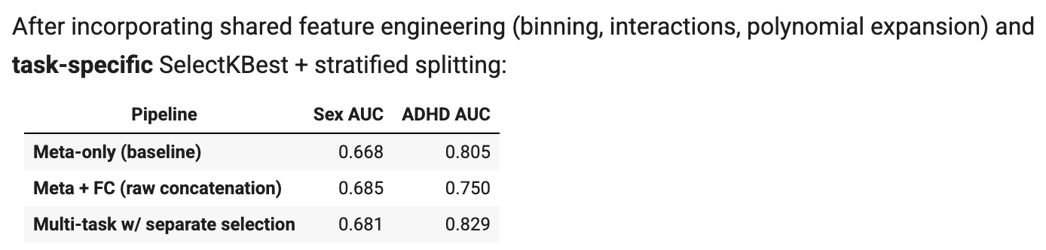
Discovery (Logistic Model)
- ADHD: We recovered and even slightly improved performance (0.805 → 0.829) by isolating noise, doing PCA‑style expansions, then selecting the top 20 ADHD‑related features.
- Sex: AUC nudged up modestly (0.668 → 0.681) when we likewise applied tailored selection, but gains remain limited.

Slide 15
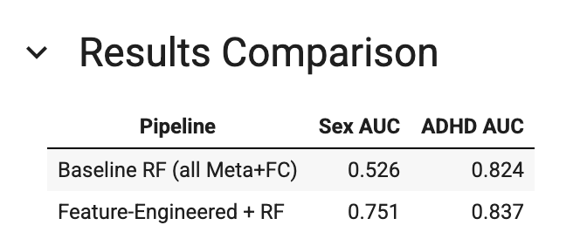
Discovery (Random Forest Model)
ADHD: Feature engineering and targeted feature selection improved AUC from ~0.82 → 0.837.
Sex: Major boost from AUC ~0.53 → 0.751, indicating that our engineered Meta‑only features plus per‑task selection capture much stronger sex‑related signal.
Next Steps:
Consider cross‑validation and hyperparameter tuning on the 20‑feature subsets.

Slide 16
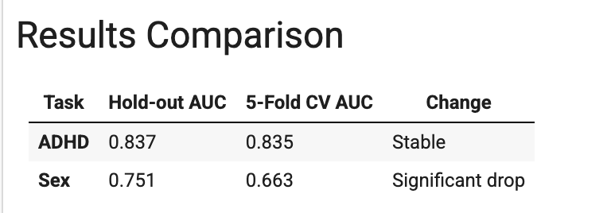
Discovery (Random Forest Model)
ADHD prediction remains consistent between a single hold‑out split and 5‑fold cross‑validation (AUC ≈ 0.836), indicating that our current Random Forest + feature engineering pipeline is well‑tuned and not overfitting.
Sex prediction suffers a notable performance decline under cross‑validation (from ≈ 0.75 down to ≈ 0.66), revealing that the existing meta and functional connectivity features do not strongly capture gender-related signals. The earlier hold‑out result likely overestimated true generalization.

Slide 17
Next Step

